Slide 1

Incentive based PlasTIc Waste segregation
Project by,
Atul Ajani

Slide 2
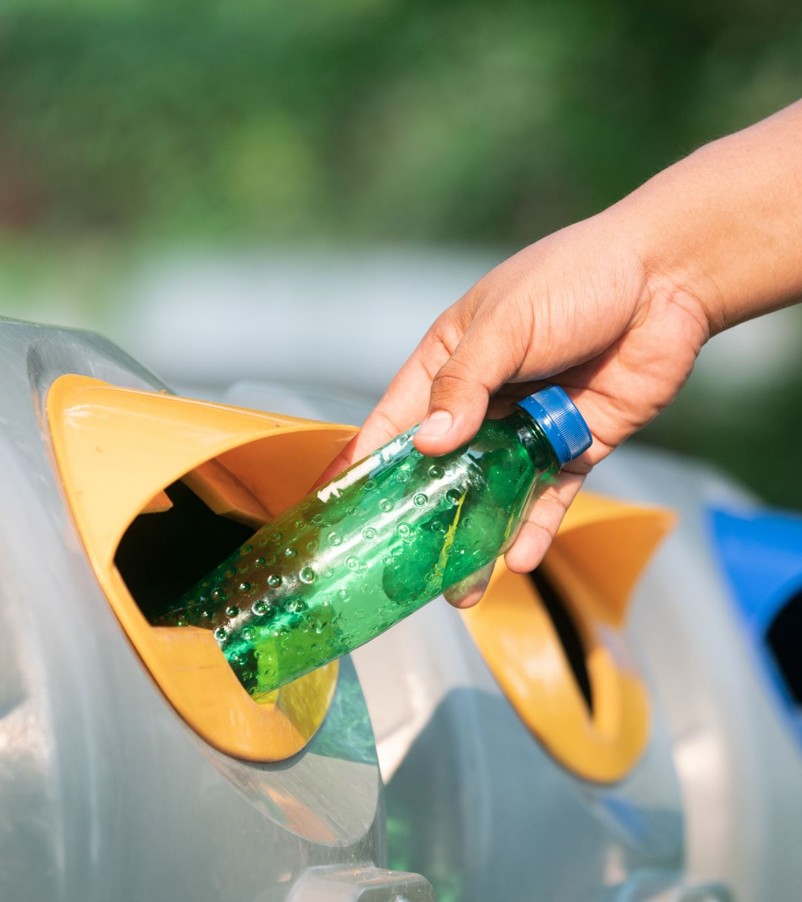
Introduction
Plastic waste accumulation is an ever-increasing threat to life on earth. The negative effects of excess plastic wastes have become prominent in the recent years, and hence the need for proper disposal of plastic have become a necessity.
Problem Statement:
Improper disposal of large amounts of plastic wastes requires the need to be tackled using innovative solutions.

Slide 3
solution
An efficient way to tackle improper disposal of plastic wastes is by proper and efficient segregation of plastic wastes at the source and encouraging people/users to dispose the plastic wastes properly. \
Researches show that an incentive-based approach to plastic waste disposal encourages the users to properly dispose off plastic wastes.
Project Aim
Hence this project aims at developing an ML model which identifies the different grades of plastic wastes and displays the recycling cost set by the recycling units. A percentage of these recycling costs can be given to the people who dispose these plastic wastes thus encouraging them for more efficient disposal.

Slide 4
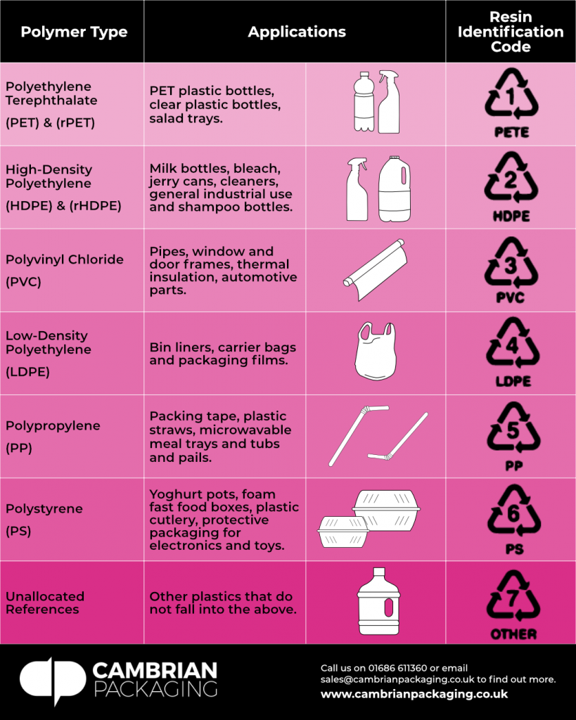
Resin code classification

Slide 5
Machine learning model using CNN
Convolutional Neural Network algorithm has been used to develop a model to identify the resin codes and return the price of recycling.
Steps:
Using mnist model to identify the numbers
Developed a model which classifies the different grades of plastic
Real-time analysis of prediction of the different grades of plastic has been done.

Slide 6
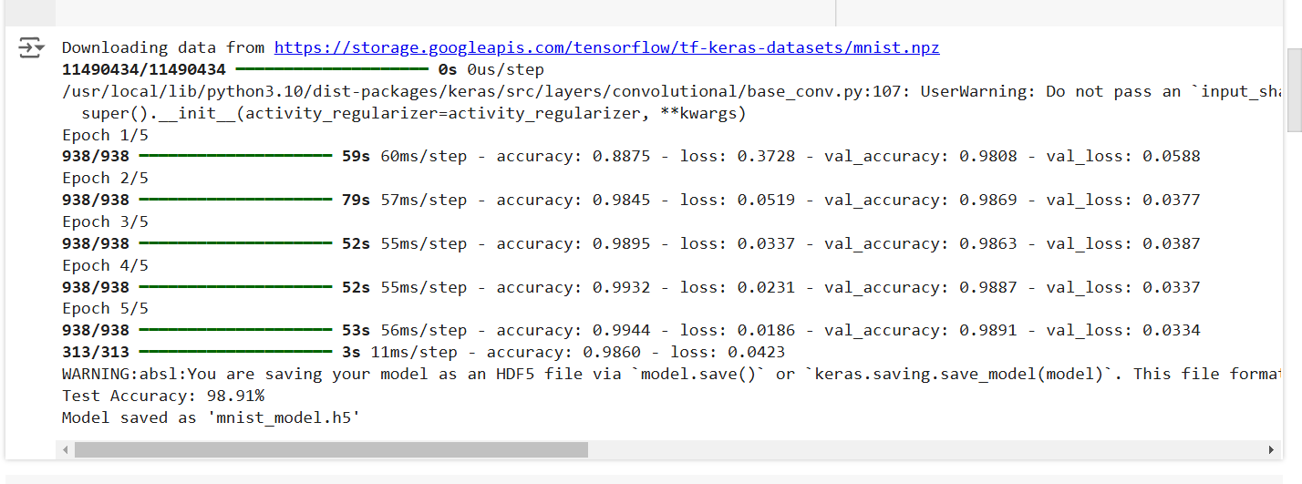
MNIST Model

Slide 7
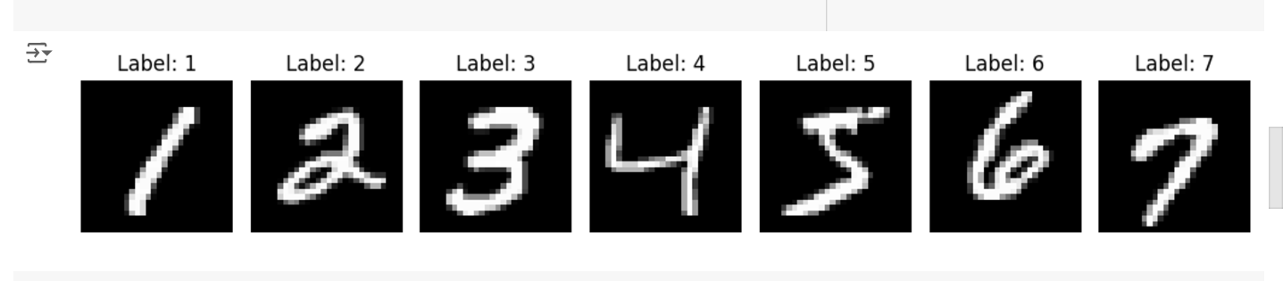

Slide 8
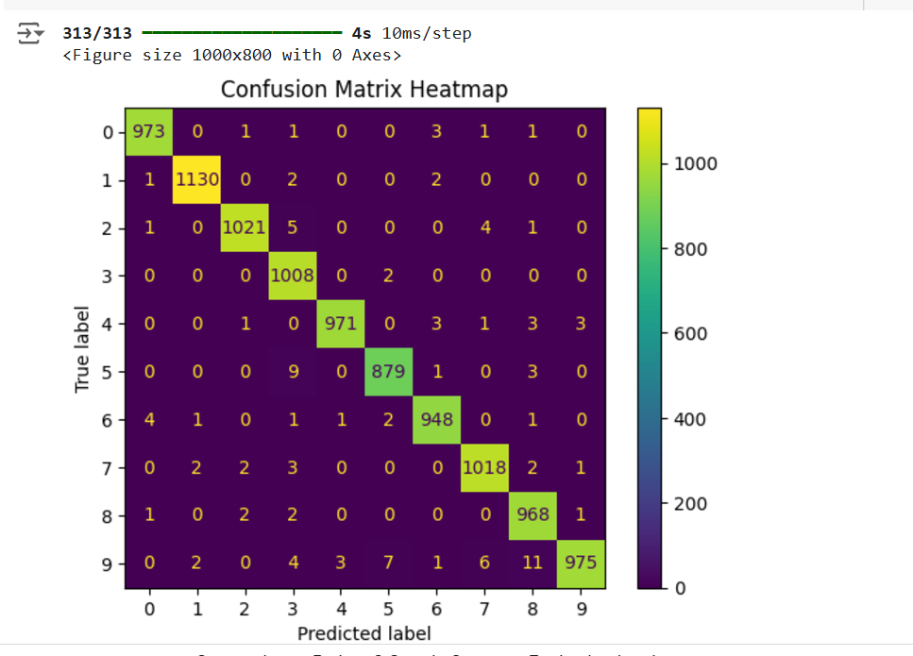

Slide 9
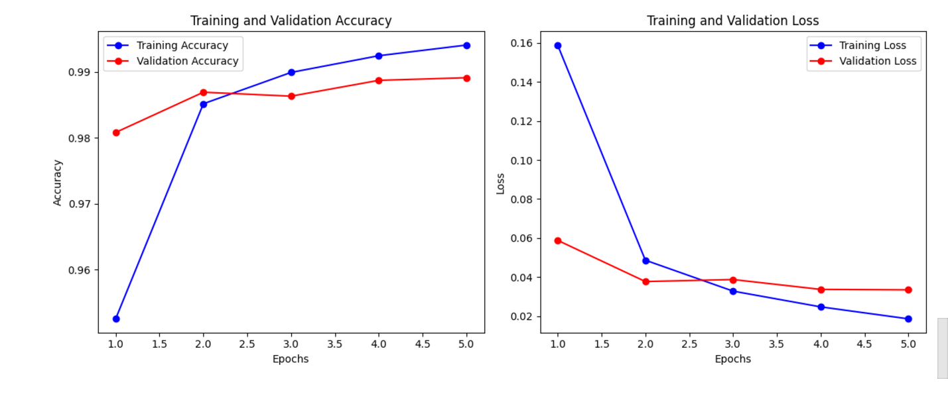

Slide 10
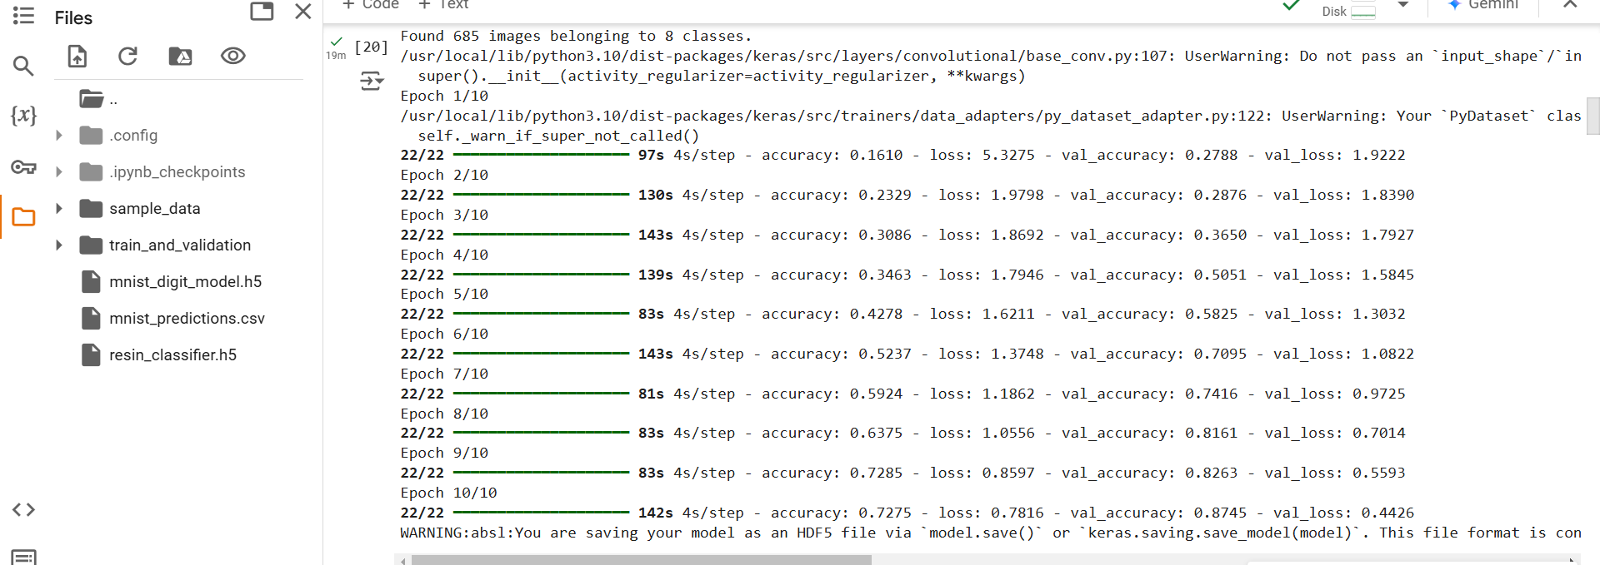
RESIN CODE CLASSIFier model

Slide 11
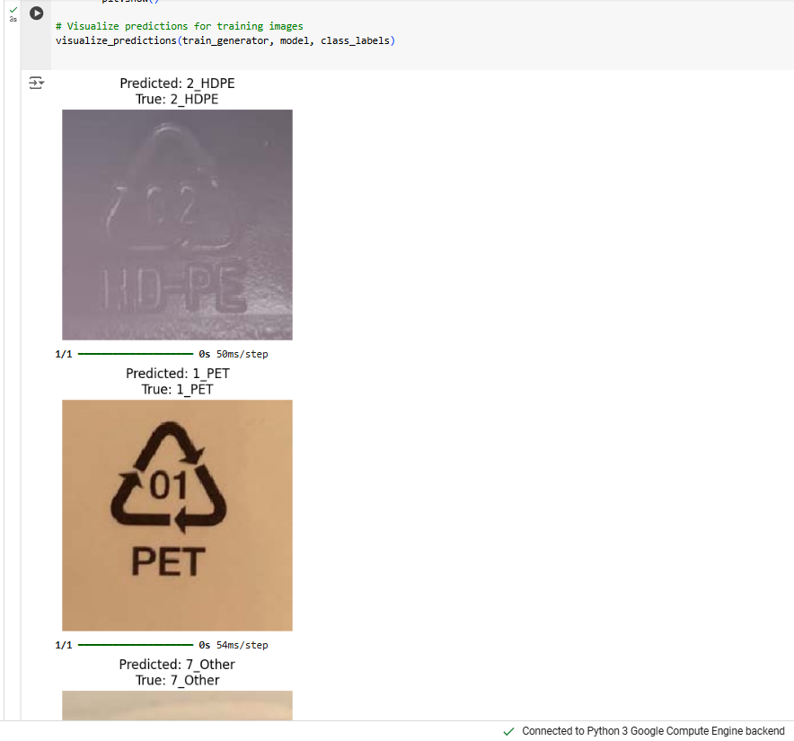
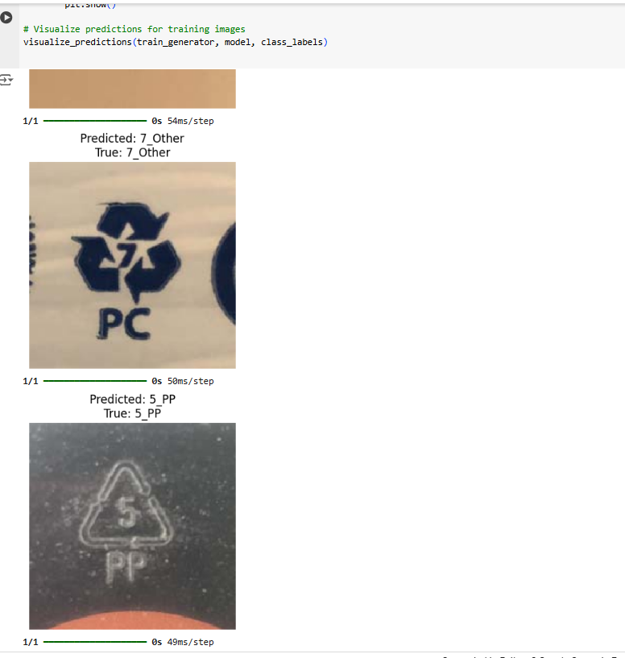

Slide 12
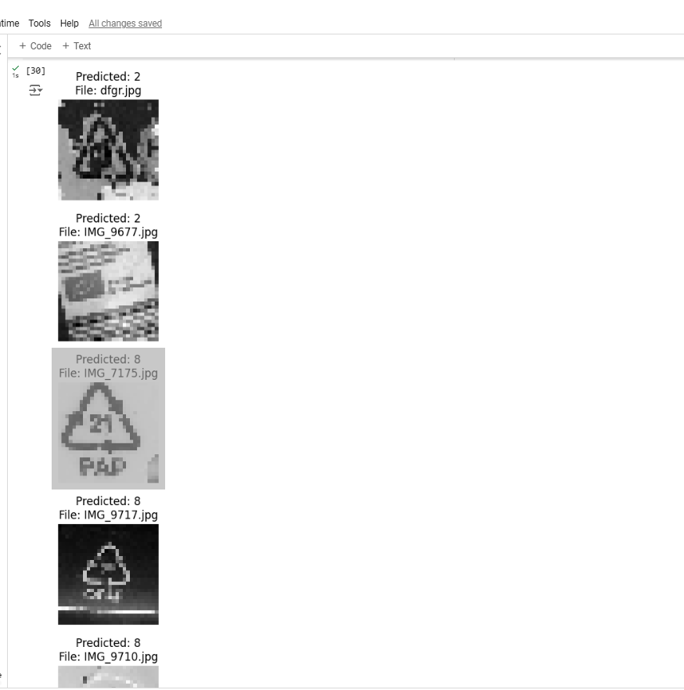
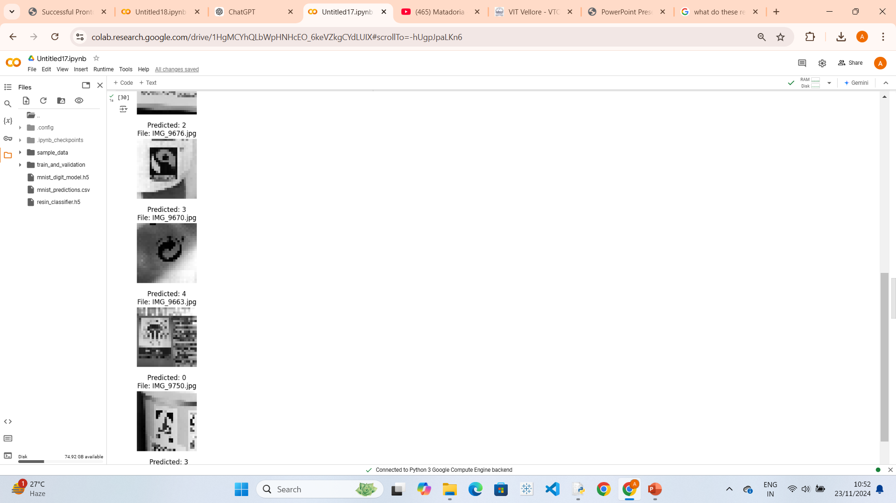

Slide 13
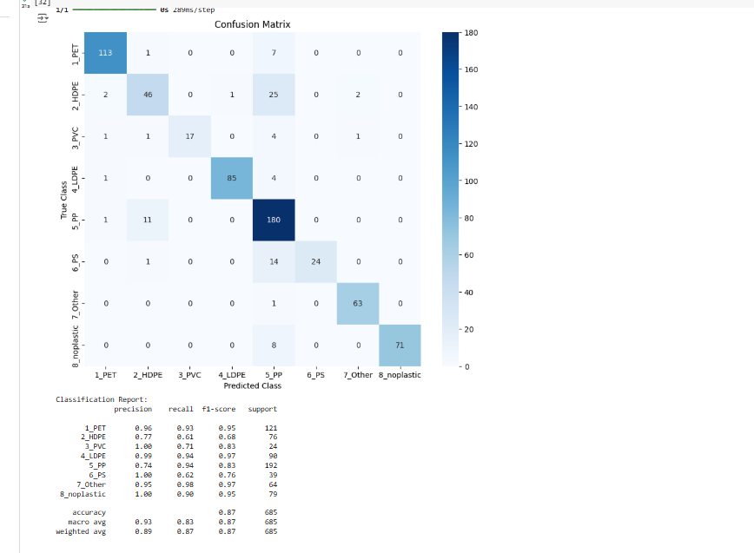

Slide 14
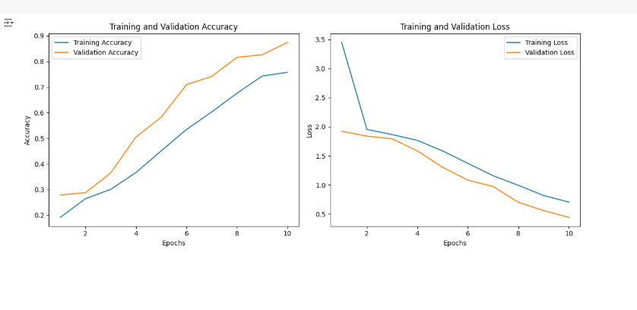

Slide 15
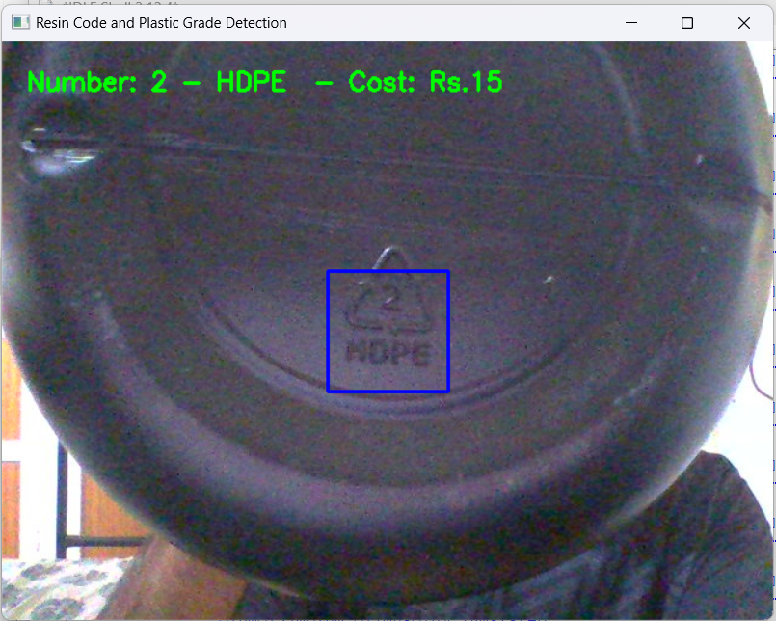
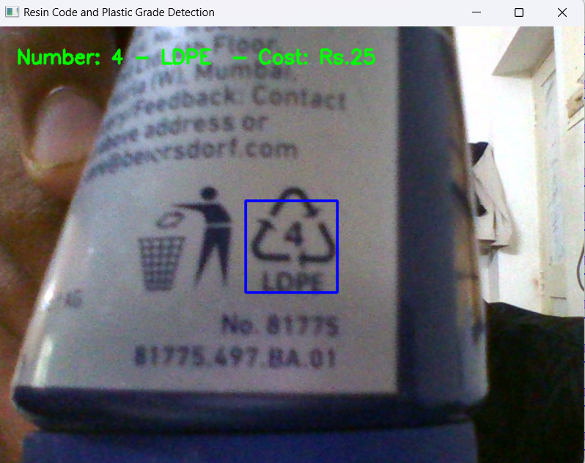
REAL TIME ANALYSIS

Slide 16
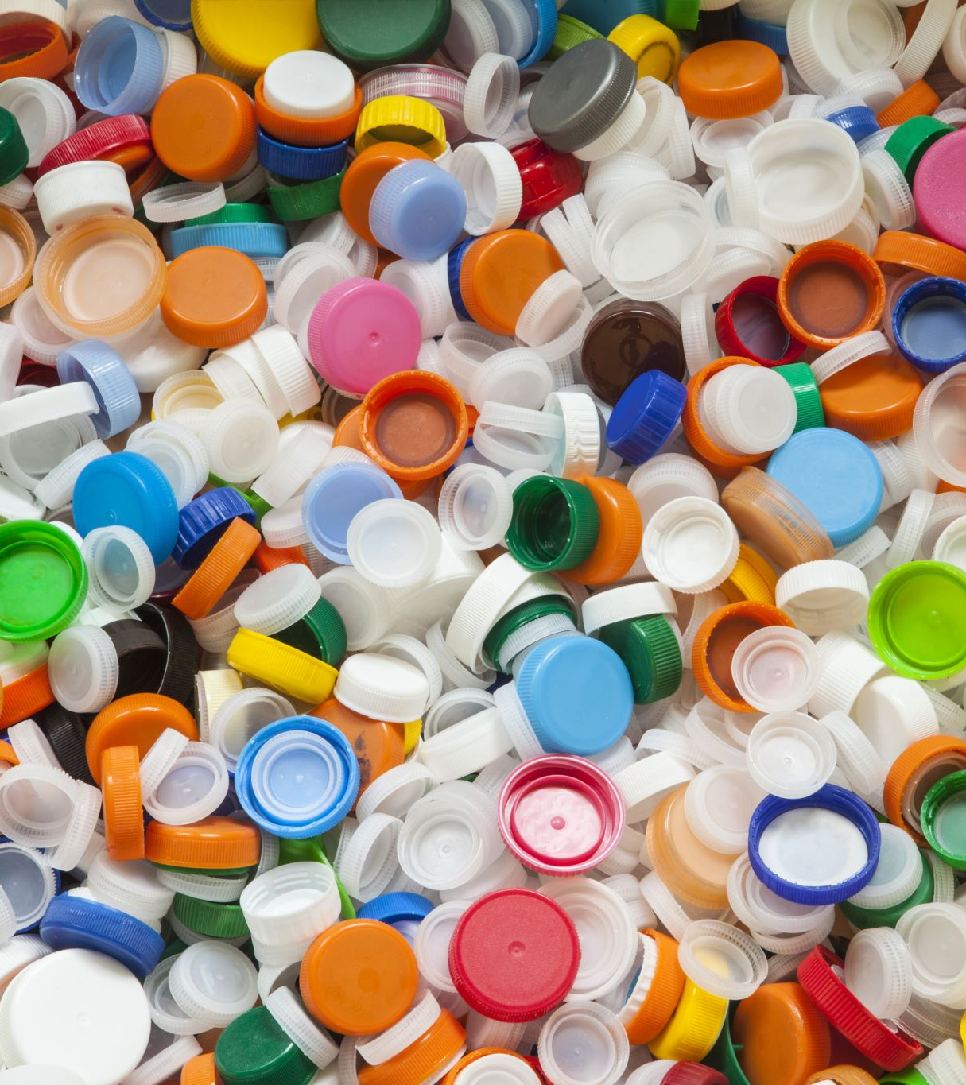
Conclusion
AN ML model has been developed to identify the grade of plastic. Even though, the recycling costs are determined by various other factors too, resin codes and the grade of plastics is a major factor in determining the costs.
Government policies have already been initiated to hold the companies which produce plastic products responsible for collection of their respective plastic wastes. The future scope of the project lies in utilizing the ML model for correct collection and segregation of plastic wastes and encouraging users through incentives to properly dispose off the plastic wastes.

